Slide 1
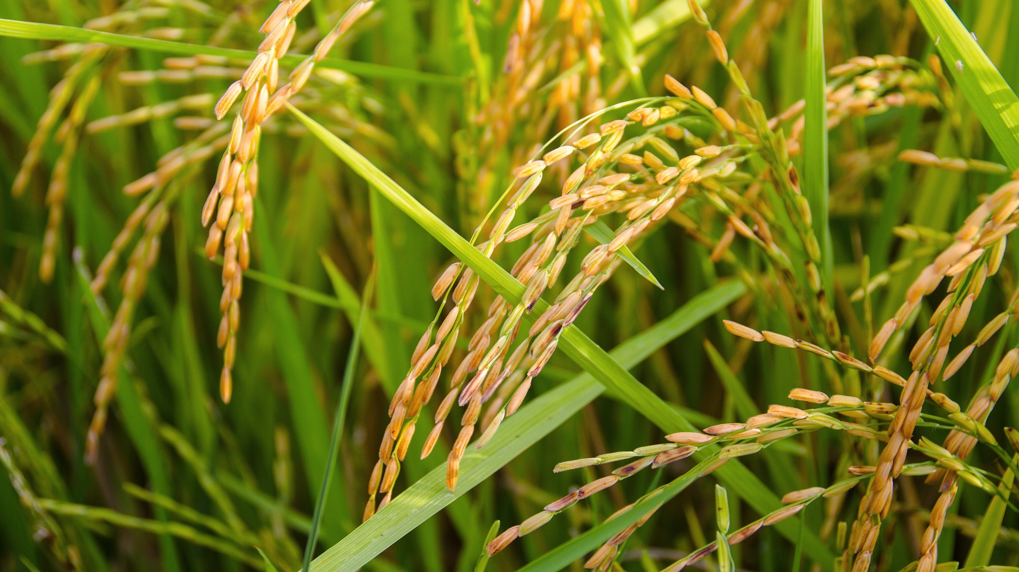

FarmConnect Community (Team Kisan)

Slide 2
TEAM MEMBERS
S.NO | NAME | ROLL NUMBER
1 | Ponnana Varahala Naidu | 2110030062
2 | Vikram Reddy | 2110030007
3 | Aravind Sagar | 2110030073
4 | Jarpat Chandrashekar | 2110030101
5 | Dileep Reddy | 2110030307

Slide 3
DOMAIN NAME
Domain Name - Agriculture.
I Aim To Build A Platform Dedicated To Agricultural Innovation And Education. Through This Domain.
I Envision Fostering Collaboration And Sharing Knowledge Within The Farmer By Our Community.
Agriculture Encompasses The Cultivation Of Crop, Raising Livestock, And The Management Of Land For Sustainable Food Production.
It Is Not Only A Fundamental Aspect Of Human Survival But Also A Dynamic Field That Intersects With Technology, Economics, And Environmental Conservation.

Slide 4
IDENTIFY PROBLEM
Problem Statement - Significant Problem Between Farmer And Consumer When Selling Crop.
One Significant Problem Between Farmer And Consumer When Selling Crop Is The Lack Of Direct Communication And Understanding Between The Two Parties.
Farmer May Struggle To Reach Consumers Directly, Relying Instead On Middlemen Or Distributor, Which Can Result In Price Discrepancies And Reduced Profit For A Farmer.
On The Other Hand, Consumer May Face Challenges In Accessing Fresh, Locally Grown Produce Or Understanding The True Value Of The Agricultural Product They Purchase.
This Disconnect Can Lead To Inefficiencies In The Supply Chain, Limited Transparency, And A Loss Of Trust Between Farmer And Consumer.

Slide 5
SOLUTION
Solution – FarmConnect Website.
FarmConnect Is A Community Works Between A Farmer And Consumer Which We Takes The Entire Risk Associated With Selling Crop To Consumer, including Addressing Transportation Issue, Gaining Maximizing Profit, Taking Risk For Loading Crop Into The Transport And Many More.
FarmConnect Community Educated Intermediary Can Provide Valuable Market Insights, Helping The Farmer Understand Consumer Preferences, Demand Trends, And Pricing Dynamics.
They Can Efficiently Manage The Logistics Of Distributing The Produce, Coordinating Transportation, Storage, And Delivery To Ensure Timely And Reliable Supply To Consumers.
An Educated Intermediary Can Navigate Regulatory Requirement And Ensure That The Farmer Produce Meets All Necessary Standard And Certification For Sale To Consumer.

Slide 6
OBJECTIVE
Aim To Shorten The Supply Chain By Connecting Farmer Directly With Consumer, Eliminating The Markup By Middlemen.
This Could Involve Creating A System Where Farmer And Consumer Have Access To Real-Time Information About Crop Price, Quality, And Origin.
Increase Farm Profitability Could Involve Finding New Market For Crop, Securing Fairer Pricing From Existing Buyer, Or Reducing Production Cost.
Encourage Consumer Demand For Product Grown With Method That Is Environmentally Friendly And Socially Responsible.
These Are The Specific Objective Will Depend On The Nature Of The Problem We Are Trying To Address Between A Farmer And Consumer.

Slide 7
RESULT ANALYSIS
Regulatory Compliance: An Educated Intermediary Can Navigate Regulatory Requirement And Ensure That The Farmer Produce Meet All Necessary Standard And Certification For Sale To Consumer.
Customer Service: They Can Provide Excellent Customer Service, Addressing Consumer Inquiries, Handling Complaints, And Building Positive Relationship With Buyer, Which Can Lead To Repeat Business And Loyalty.
Risk Mitigation: By Leveraging Their Knowledge And Expertise, Educated Intermediaries Can Help Mitigate Risk For Both The Farmer And The Consumer, Such As Ensuring Product Quality, Managing Inventory, And Minimizing Disruption in Supply Chain.
Market Knowledge: An Educated Intermediary Can Provide Valuable Market Insights, Helping The Farmer Understand Consumer Preferences, Demand Trends, And Pricing Dynamics.

Slide 8
CONCLUSION
Increased Efficiency And Profit The Educated Person Could Be A Middleman, Someone Who Facilitates The Transaction Between Farmer And Consumer.
Knowledge Of Market, Transportation, And Storage, They Could Potentially Get The Farmer A Better Price For Their Crop And Ensure The Consumer Get A Good Quality Product. This Could Benefit Everyone Involved.
Improved Quality And Safety: The Educated Person Could Be An Agricultural Extension Agent, Someone Who Applies Scientific Knowledge To Farming Practices.
Overall, The Impact Of An Educated Person Working Between Farmer And Consumer Depends On The Specific Role And The Goals Involved.

Slide 9
FUTURE SCOPE
An Educated Person Working Between Farmer And Consumer, Often Called An Agricultural Intermediary Has A Bright Future Scope In The Evolving Agricultural Landscape.
They Can Help Farmer Adopt New Technologies Like Precision Agriculture, Sustainable Practices, And Data-Driven Decision Making To Improve Yields And Resource Management.
They Can Bridge The Gap Between Consumer Preferences And Farmer Production By Educating Consumers About Local, Seasonal Produce, Sustainable Farming Methods
Help To Develop And Manage Online Platform For Farmer To Sell Directly To Consumer, Streamlining Transactions And Logistics.

